Slide 1
Augmented Reality: Education
Project Plan
Prepared By:
Mentey Satya Venkata Ranga Janaki Sriram
Chithari Amaravati Rajiv Varma
Pandala Sireesha
Nukala Lakshmi Naga Sai Sandeep

Slide 2
Problem Statement
Now a days, the vast majority of the understudies are not intrigued by customary learning process.
They got exhausted of classrooms, writing board etc.
There will be a few problems like health issues, climatic conditions in which they can be great degree of hot or cold where students cannot go to the class and focus on lectures.
Physical models, itemized delineations and notices are large costly.

Slide 3
Problem Statement
Further, these learning materials get worn down, loose their importance, and get lost after some time.

Slide 4
Solutions
By incorporating augmented reality in lectures, educators can catch the attention of students.
Understudies can get models on their own gadgets and by means of Augment’s application.
By viewing enlarged models, the understudies can pick up a superior comprehension of the ideas they are examining.
This is a fun method to connect with understudies and fortify ideas they have seen amid of class lectures.

Slide 5
Solutions
With Augment, we don't need to put resources into physical materials.
Understudies can get to models from any gadget whenever. Regardless of whether they are at home or in the classroom, they can examine and communicate with the course materials.

Slide 6
Solutions
In this project, We make application which provide real time calculations with augmented reality in it.
Using Camera in the device we recognize the handwriting or the mathematical notations and provide the answers for them.
We provide calculations all the basic Arthematic, Geometrical, Trigonometric and Calculus.

Slide 7
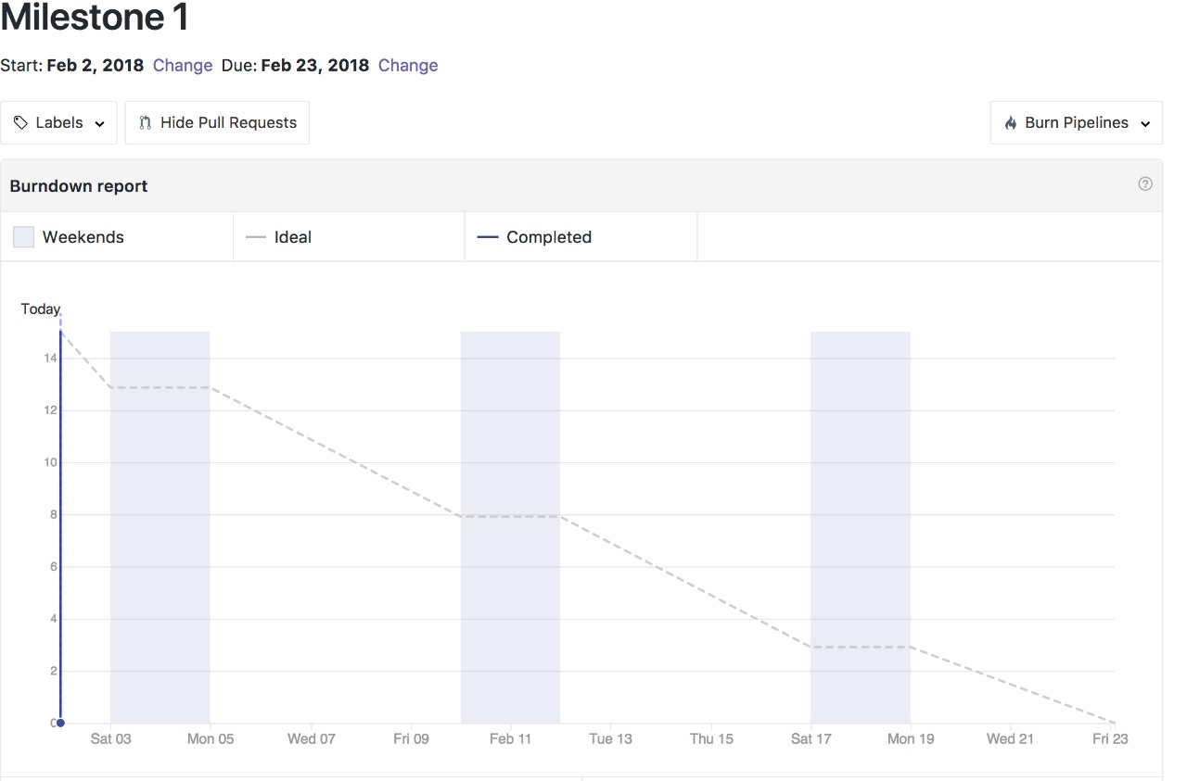
Burndown graph for Increment 1

Slide 8
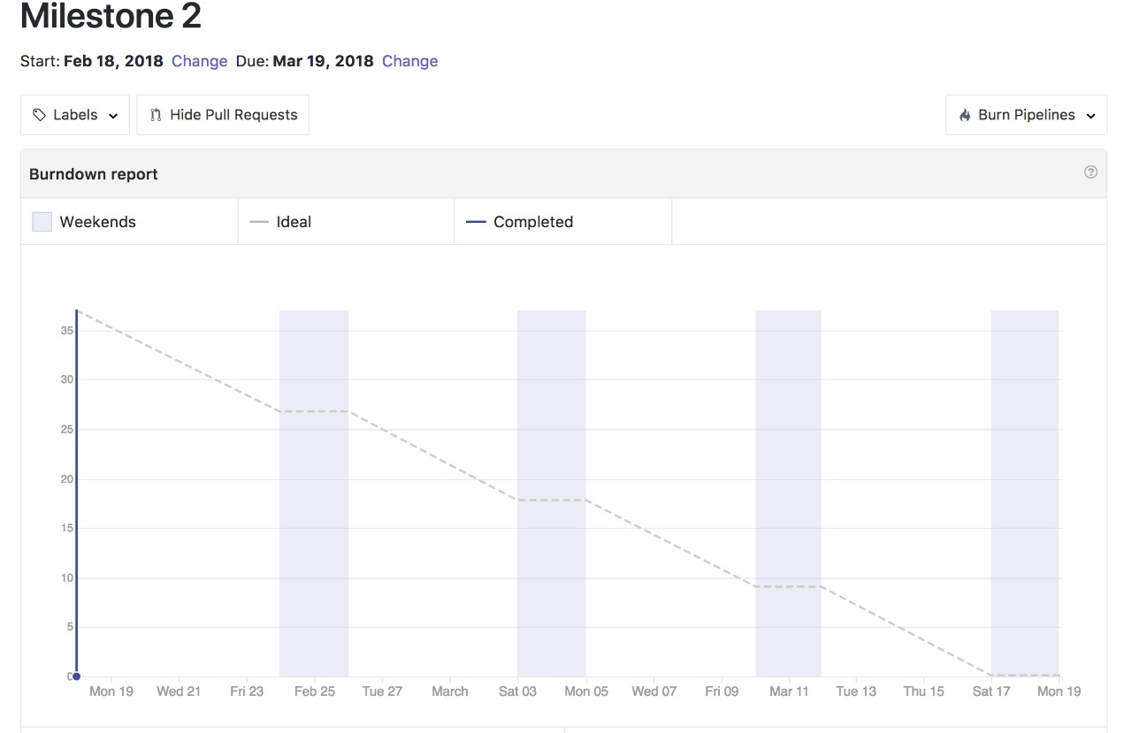
Burndown graph for Increment 2

Slide 9
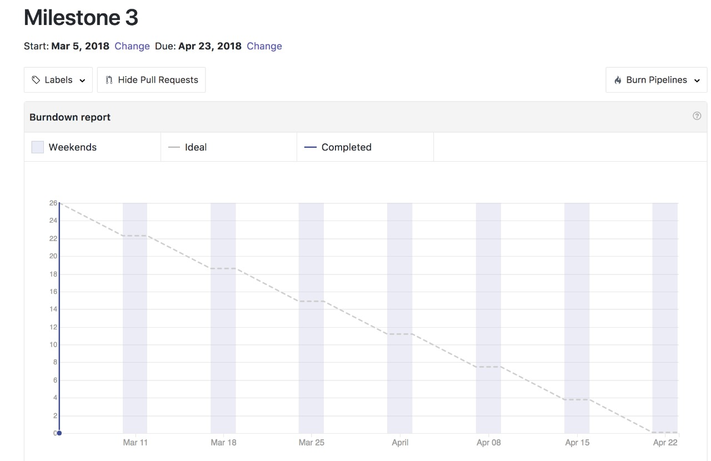
Burndown graph for Increment 3

Slide 10
THANK YOU

